Slide 1
Association between depression and poverty
Daniel lagos
Ana 500
October 16, 2022
https://github.com/danlagos/ANA500-Week-3

Slide 2
Problem statement
Background: Using California Health Interview Survey (CHIS) 2020 to search for an quantify the association between depression and poverty levels after controlling for general health, and current smoking habits in adults in the state of California.
Objective
How does poverty levels affect depression in adults?
What are the effects of general health and smoking habits, and do they interact with poverty levels?
Cam a machine learning model predict depression based on poverty levels after accounting for general health, and smoking habits?

Slide 3
Hypothesis formulation
H₀: There is no statistically significant association between depression and poverty levels after controlling for general health, and current smoking habits
H_{A}: There is a statistically significant association between depression and poverty levels after controlling for general health, and current smoking habits

Slide 4
Top-down program design
Overall Task: Develop Python program that takes CHIS 2020 as input (poverty, general health, smoking habits) and outputs predicted effect on depression levels.
VAR AJ32: captures results of survey question “Feeling depressed in the past 30 days?
VAR AJ32 is categorical, numeric. Coding provided in visualization section
Steps to take
Acquire: identify data set, retrieve data, query data. CHIS has already been selected. Currently in SAS XPT format.
Prepare: analyze codebook, explore and process data using python and discovery from codebook.
Analyze data: select analytical technique, build model
Report: communicate results – not inclusive to code development
Act: apply results, connect results with problem statement – not inclusive to code development

Slide 5
Hierarchy chart
DEPRESSION = CHIS2020DATASET(POVERTY, GENERAL HEALTH, SMOKING)
Main Program( output depression, input CHIS dataset with variables for poverty levels, general health, and current smoking habits)

Slide 6
Flow chart
Start
Load data
Preliminary analysis: ID data set features, statistically describe data
Visualize: Plot each feature against output variable (depression) to understand data
Clean Data: handle missing values

Slide 7
Flow chart
Select Analytical Technique: Decision Tree
Estimator: DecisionTreeClassifier from scikit-learn
Split Data:
Split Data into data frame with dependent variable, and independent variables. Split data into training and testing data sets

Slide 8
Flow chart
Train Estimator:
Use training set
Test Estimator:
Predict using test data
Assess Model Performance:
Accuracy score
Precision score
Recall Score

Slide 9
Flow chart
Report Results:
Histogram of predictions
Plot of Decision Tree
Act:
Produce a set of recommendations

Slide 10
pseudocode
# Start
# STEP 1 Acquire data: from CHIS website
# Import libraries: pandas, NumPy, seaborn, matplotlib
# Read dataset: import data. Must read in SAS XPT file into Python
#STEP 2: Prepare – conduct analysis of codebook – identify appropriate variables, and determine structure
# read data: data.head(), data.info()
# Format data: create new data set with appropriate variables–
SMOKING, AB1 (GEN_HEALTH), POVLL (POVERTY), AJ32 (DEPRESSION)
Esnure DEPRESSION is binary.
Coding: 1 = Depressed, 2 = not-depressed

Slide 11
pseudocode
# Remove inappropriate values – AJ32(Variable for depression) contains value of -2 (means proxy skipped). Not applicable, remove.
# Visualization: make histograms, scatter plots and bar charts, use as appropriate.
# STEP 3: Analyze
# Create two new data sets, one that contains Var DEPRESSION (Y data frame), the other that contains POVERTY, GEN_HEALTH, SMOKING (X data frame)
# Further separate into testing and training data frames (Y_train, Y_test, X_train, X_test)

Slide 12
pseudocode
Train classifier
Max leaf node = 10
Max depth = 5
Criterion = entropy, classifiers based on entropy are better with nonbinary categorical variables as compared to gini index.
Predict on test data
Assess
Accuracy score
Precision score
Recall Score
Plot of decision tree
Plot of feature importance’s – to determine how algorithm weights the importance of each variable.

Slide 13
Acquire
Data set was acquired via CHIS website (https://healthpolicy.ucla.edu/chis/data/pages/getchisdata.aspx). This is a well respected and well cited survey repository that conducts surveys to delve into California's public health issues.
CHIS website proved extensive codebook to assist in analysis and will be relied upon for the data preparation of this project.

Slide 14
prepare
Codebook identifies AJ32, variable for depression with value of -2, meaning proxy missing.
All other variables are categorical numeric

Slide 15
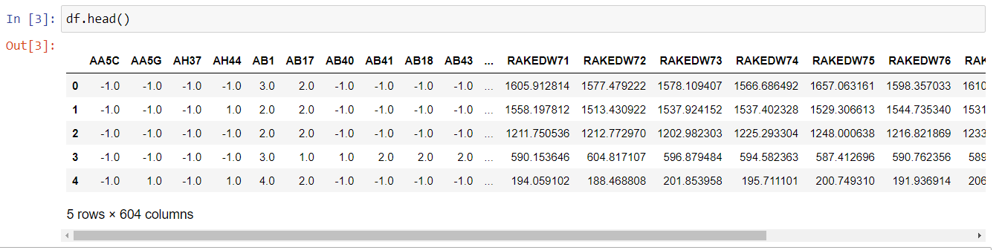
prepare

Slide 16
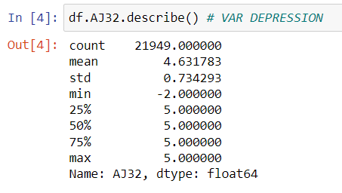
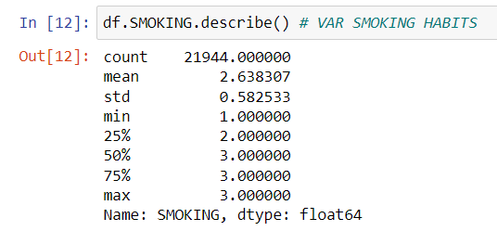
prepare
Confirming that no other variables contain unusable values. AJ32 with values of -2

Slide 17
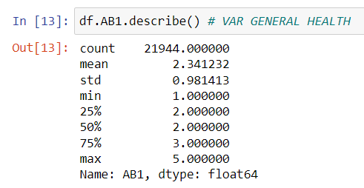
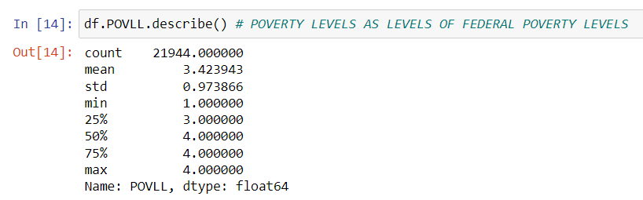
PREPARE
Confirming that no other variables contain unusable values

Slide 18
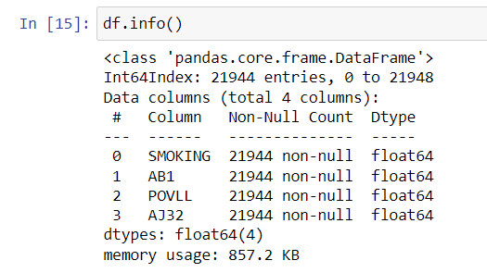
PREPARE
Confirming lack of missing values

Slide 19
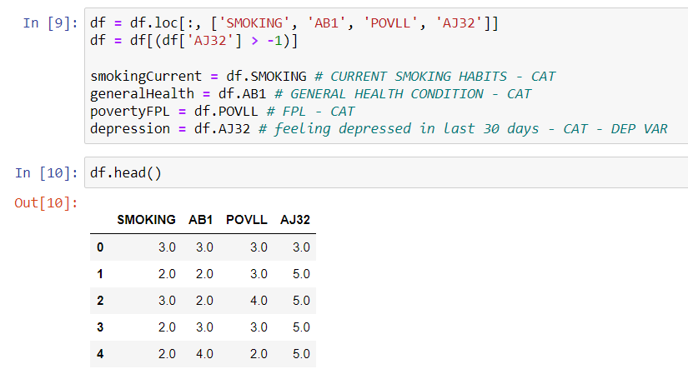
prepare
Clean data

Slide 20
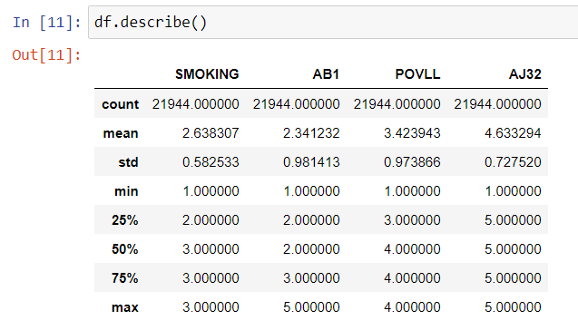
prepare
Confirming data set is clean: all values over 0, n= 21,944, devoid of variables not in use.

Slide 21
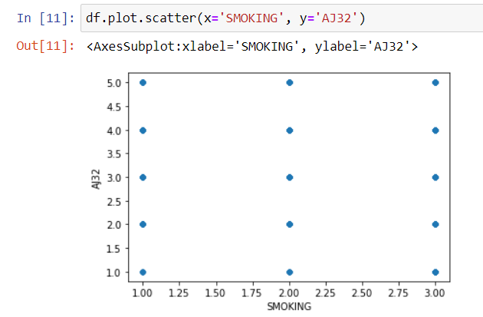
Prepare - visualization
After conducting data.hist(), data.scatter() and data.plot.box() it has been determined that scatter plots are inappropriate: example of output of scatter plot for smoking vs depression levels, below. All other scatter plots provide similar results, and not insightful, therefore not used.

Slide 22

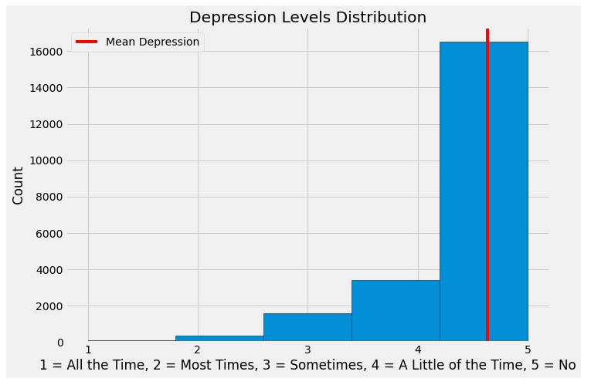
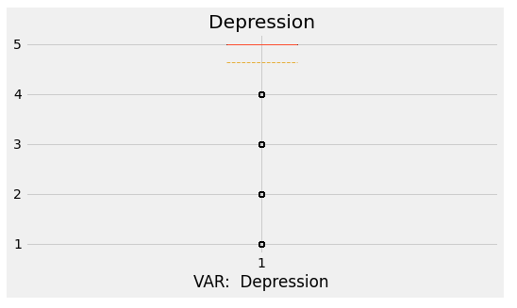
Prepare - visualization
Histogram of dependent variable DEPRESSION. Left Skew.
AJ32: Feeling depressed in the past 30 days?
Coding:
1 = all the time
2 = most of the time
3 = some of the time
4 = a little of the time
5 = not at all

Slide 23
Prepare - visualization
Observations - DEPRESSION: Very difficult to determine much from the box plot. This may be because in the histogram it appears as if there are relatively few people that are depressed compared to those that are not depressed.
Histogram shows left skew, meaning the distribution is not normal. Need to keep this in mind if using an algorithm that assumes normal data.

Slide 24
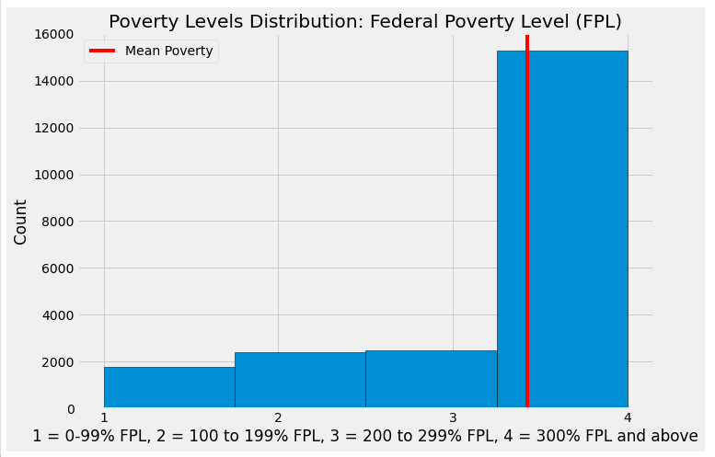
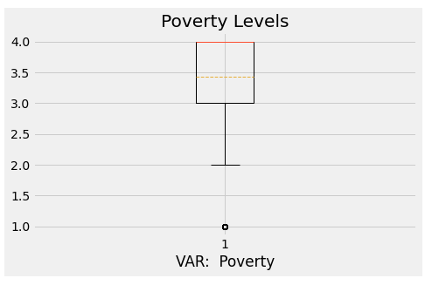
Prepare - visualization
Histogram & Boxplot of POVERTY,. Left Skew.
Federal Poverty level (FPL)
Coding
1 = 0-99% FPL
2 = 100 to 199% FPL
3 = 200 to 299% FPL
4 = 300% FPL and above

Slide 25
Prepare – visualization
Observations – POVERTY: Distribution is not normal. Merely pointing out if an algorithm is used that assumes normal distribution.
Histogram and boxplot confirms skew, confirming lack of normality in distribution
Income is generally ordinal, because poverty levels is based on Federal Poverty Levels, which is a measure of income, this distribution may have an ordinal component. This may determine the type of algorithm, or may require specific testing.

Slide 26
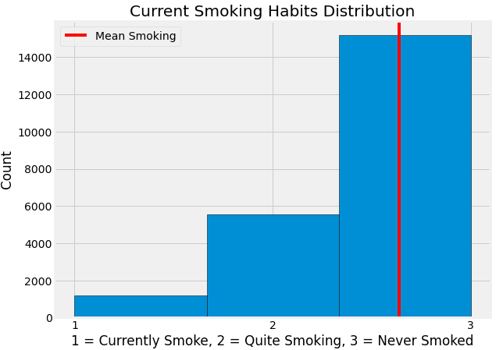
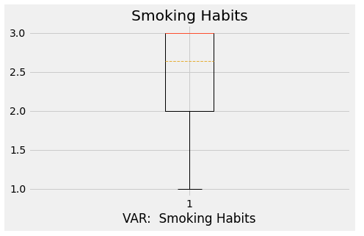
Prepare - visualization
Histogram & Boxplot of SMOKING. Left Skew.
Current smoking habits
Coding
1 = currently smokes
2 = quit smoking
3 = never smoked regularly

Slide 27
Prepare – visualization
Observations – SMOKING: As before, histogram and box plot shows left skew. This is not as important as this is not out exposure variable.

Slide 28
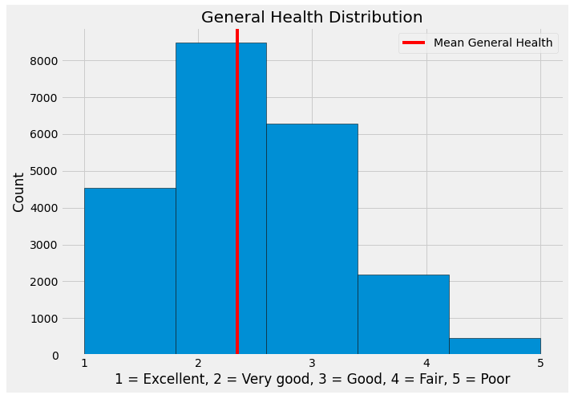
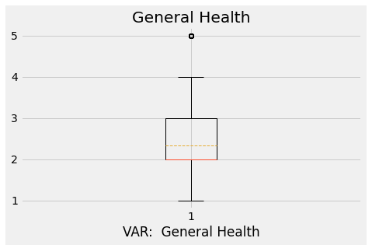
Prepare - visualization
Histogram & Boxplot GENERAL HEALTH, either right skew or might be normal. Difficult to determine.
General Health Condition
Coding
1 = excellent
2 = very good
3 = good
4 = fair
5 = poor

Slide 29
Prepare – visualization
Observations – GENERAL HEALTH: Boxplot and Histogram show that distribution may be normal.

Slide 30
Prepare – visualization
General Observations based on visualizations We are not too concerned about possible lack of normal distributions to the data. We only worry about this if using an algorithm that requires normal distribution. Right now, the possible lack of normality is merely noted. We only need to act upon this if the algorithm used calls for data with normal distributions.
POVERTY may be ordinal. Again, this is not a problem right now, but must be noted when determining the type of algorithm to use.
N = 21,944: This should be sufficient to run an analysis.
All our data is categorical. It may make sense to transform the data into binary forms to simplify the model and reduce computational power. However, there are only 4 variables in total, with 3 to 4 levels. The resulting model, and computational power required to train model may not be that complex. For now, no changes will be made to structure of data.

Slide 31
Prepare
Actions taken:
Before Analyze phase was conducted, variables were renamed so that the variable names were less ambiguous.
Var DEPRESSION was changed to a binary structure
If DEPRESSION = 5 then NEW_DEP = 2 (not depressed)
If DEPRESSION <= 5 then NEW_DEP = 1 (depressed)

Slide 32
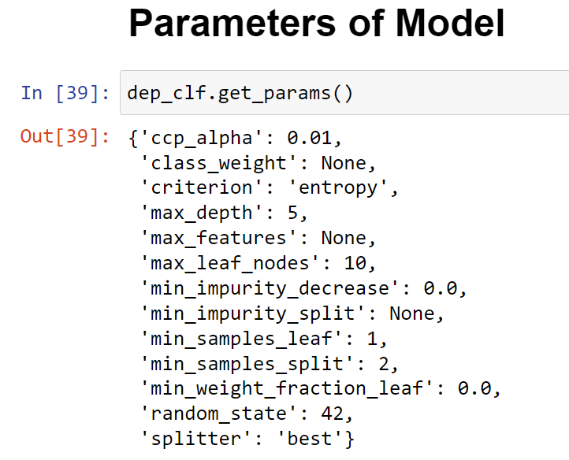
Analyze
This is a classification problem with labels, thus supervised type of ML. Decision tree algorithm will be used.
It should be noted that this model was originally run with 5 levels to var DEPRESSION. Under this version of the model the histogram of predictions, precision score, and recall score contradicted accuracy score. As a remedy, it was decided to change the structure of var DEPRESSION into binary. The results of this new model will be reported, as they are the same as the results when DEPRESSION had 5 levels.
Parameters of model provided.
Criterion = entropy as this is better suited for non-binary data.
All other parameters set to prevent overfitting.

Slide 33

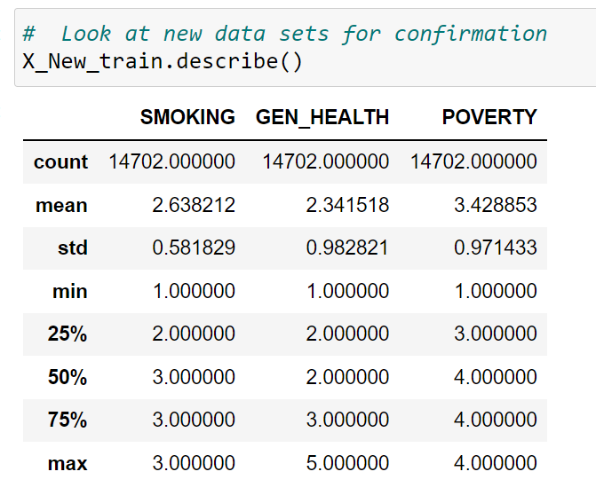
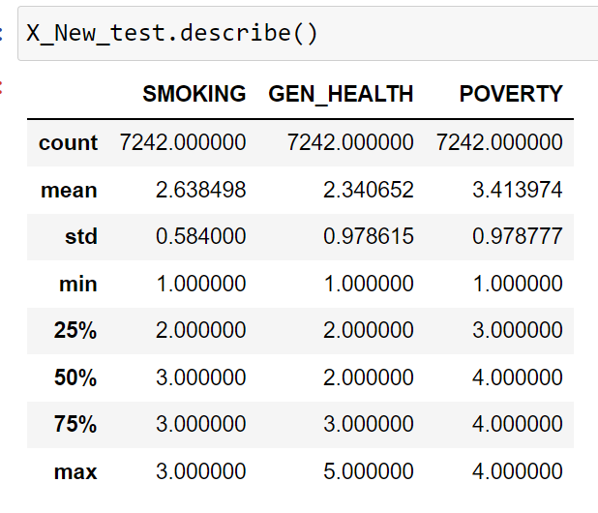
Analyze
Independent variables were split in the manner Shown above

Slide 34
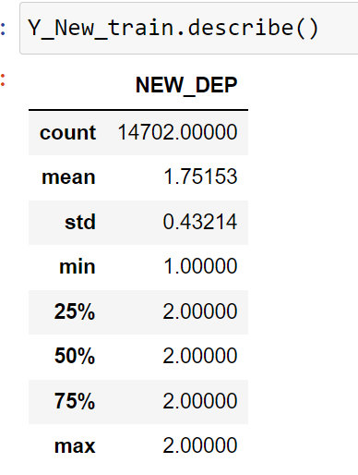
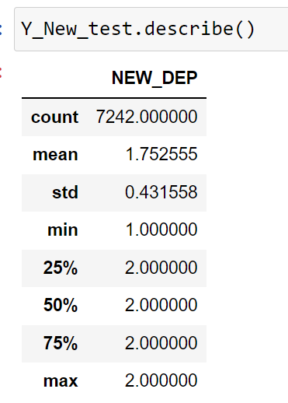
Analyze
Dependent variable was split in the manner Shown above

Slide 35
Analyze
After conducting training, the model, predictions were produced. The accuracy score, precision score, recall score was produced, as well as histogram of predictions, and a plot of decision tree were produced and analyzed.
Results in the next section.

Slide 36
Report
Accuracy score of 75.2554%
Precision score of 56.6338%
Recall score of 0.0
Though accuracy score is high, precision score just below 60% is not favorable. Furthermore, recall score of 0 typically means classifier is not truly predicting True Positives.

Slide 37
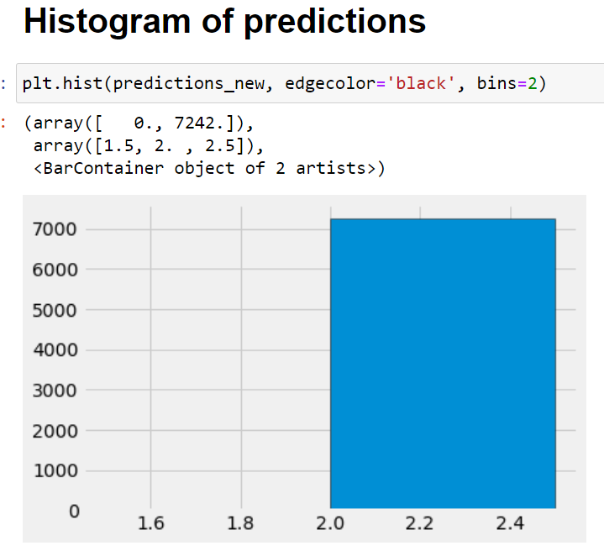
Report
Histogram of predictions indicates that model is not considering DEPRESSION(1).

Slide 38
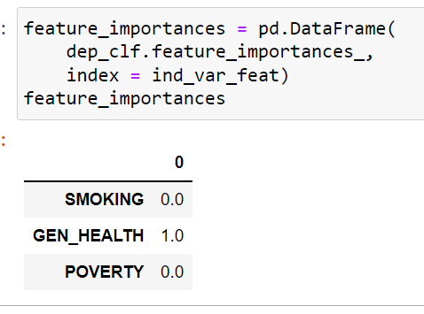
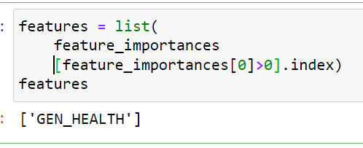
Report
Feature importance: This is meant to determine how the model is weighing the variables
Output clearly shows that GEN_HEALTH is the only variable considered important by the model.

Slide 39
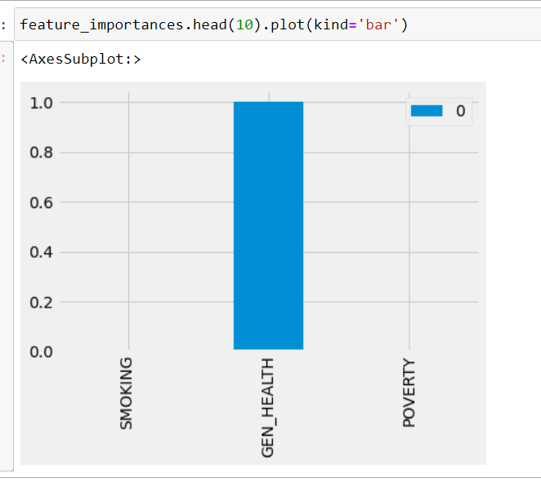
Report
Bar chart confirms output from previous slide, that is that SMOKING and POVERTY are not considered.
This may be the reason for the contradiction between accuracy score and precision and recall scores.

Slide 40
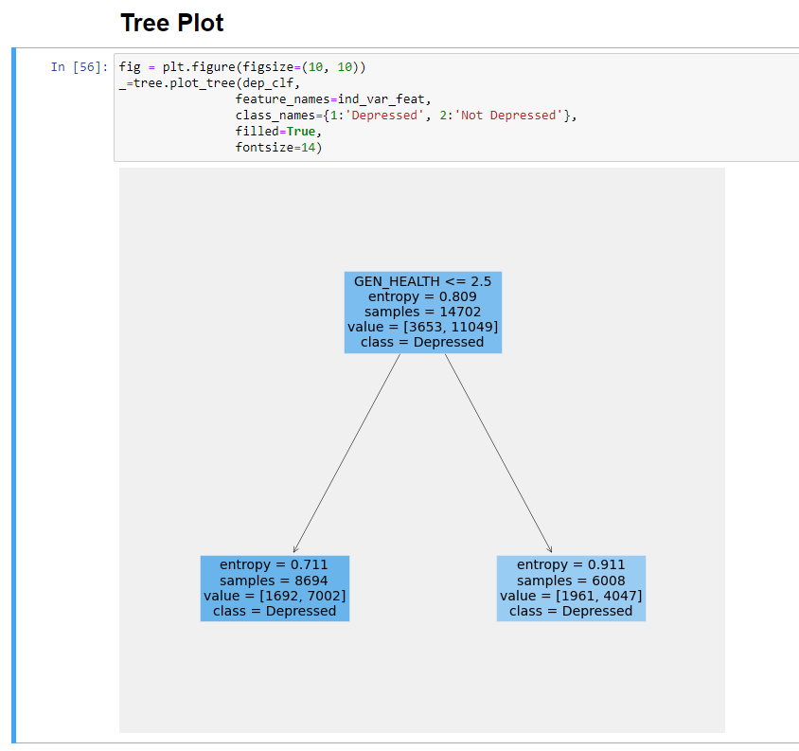
Report
Plot of Decision Tree indicates no real depth to the model.
Plot confirms that DEPRESSION is the only variable considered important by the decision tree classifier.

Slide 41
Act
Model is ignoring two of the three variables. Normally this would indicate that GEN_HEALTH is the only variable that is relevant to predicting DEPRESSION. The implication here is that POVERTY is not related to DEPRESSION, forcing us to reject H_A, and accept H_0. However, the contradiction between accuracy score and precision and recall scores indicates that DEPRESSION = f(GEN_HEALTH) is not a good model on its own, something else may be going on.
We provide two possible courses of action:
Because GEN_HEALTH is a predictor, and POVERTY and SMOKING are not considered, the model can be re-run with more than 3 independent variables. This will leverage the power of a decision tree, and possibly produce a model with better precision and recall scores.
Run the same variables, but with a regression type of model, possibly a multivariate regression.
It should be noted, that when this model was run with 5 categories for DEPRESSION, we received the exact same values for accuracy, precision and recalls scores. The levels of categories was a non-issue.

Slide 42
Act
In short, the results of this model are inconclusive, and further analysis is required either by adding variables, or using a different analytical technique.
Given that other published research has shown that poverty does affect depression, and the contradictions found in this analysis, it may be that the wrong technique was applied. Therefore, recommend that the same variables be used with a different type of model. One that involves a multivariate regression would seem the most favorable.

